Slide 1
SS ZG 526: Distributed Computing
Cluster Computing continued…
Acknowledgement: Few slides adapted from Kai Hwang, University of Southern California
Chittaranjan Hota
Professor, Dept. of Computer Sc. & Information Systems
BITS, Pilani Hyderabad Campus, Hyderabad
hota@hyderabad.bits-pilani.ac.in

Slide 2

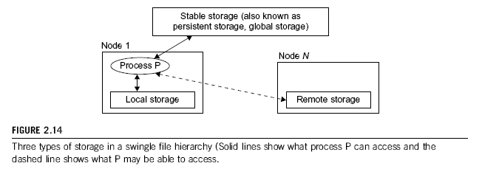
Single File Hierarchy
Single file hierarchy - the illusion of a single, huge file system image that transparently integrates local and global disks and other file devices (e.g., tapes).
large RAID disk
Birla Institute of Technology and Science, Pilani (Deemed University)

Slide 3

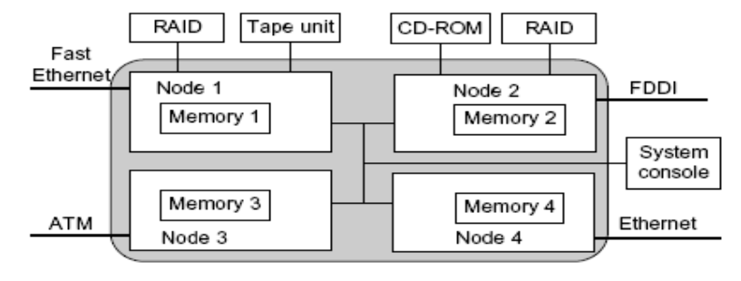
Single point of control, Networking, and Memory space
Birla Institute of Technology and Science, Pilani (Deemed University)

Slide 4

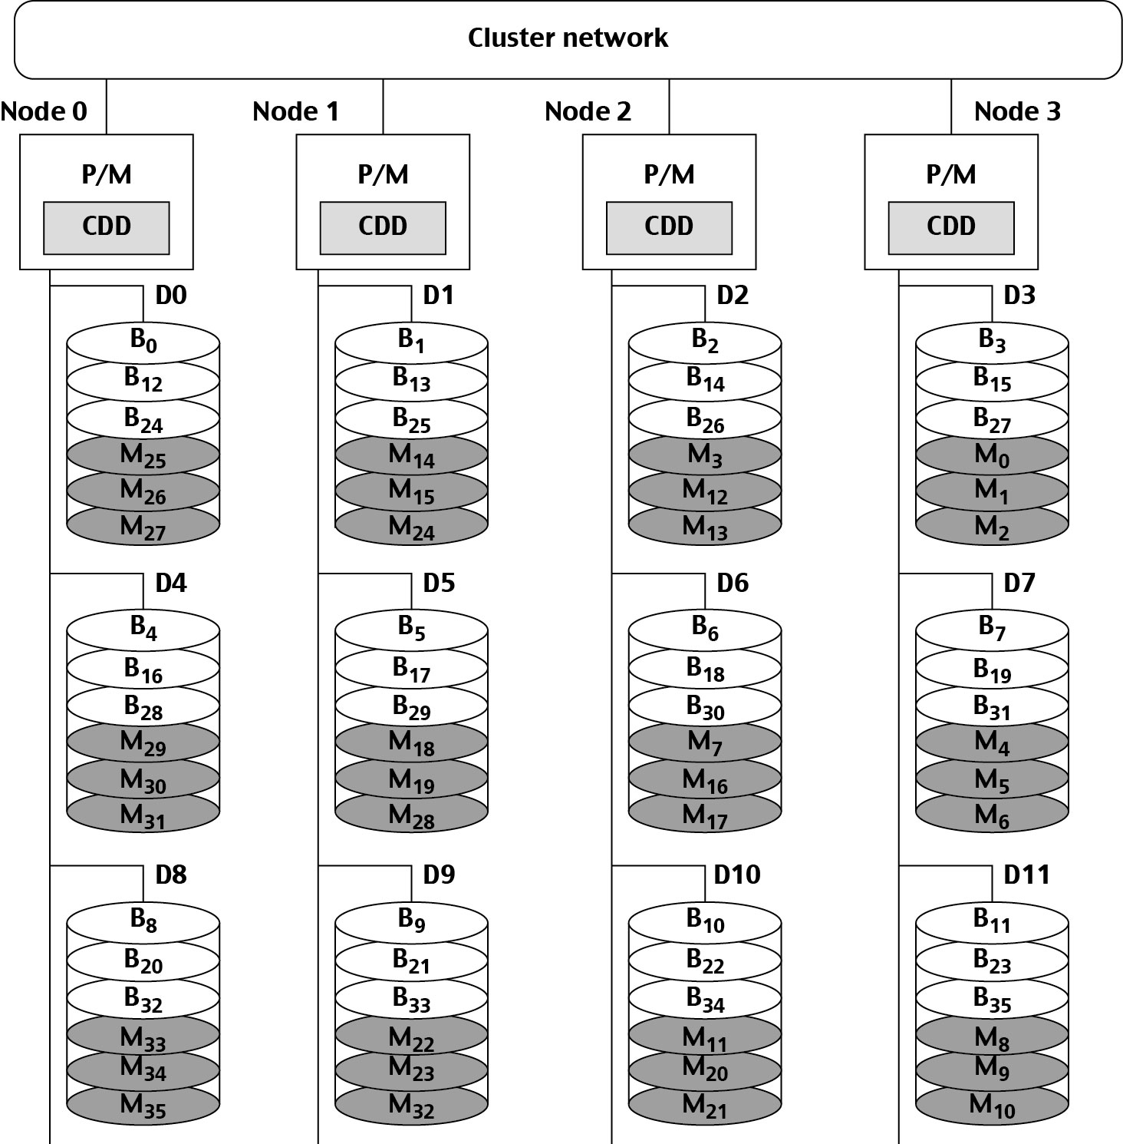
Example single I/O space
4 node Linux PC cluster: addressing is interleaved horizontally.
Orthogonal stripping and mirroring: RAID-1 equivalent capability
Birla Institute of Technology and Science, Pilani (Deemed University)

Slide 5

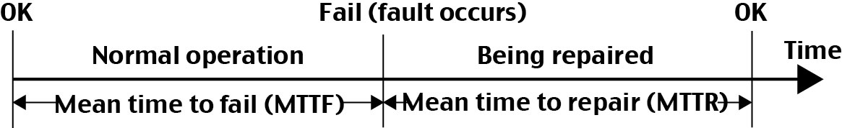
Availability
The operate-repair cycle of a computer system.
Availability = MTTF / (MTTF + MTTR)
Birla Institute of Technology and Science, Pilani (Deemed University)

Slide 6

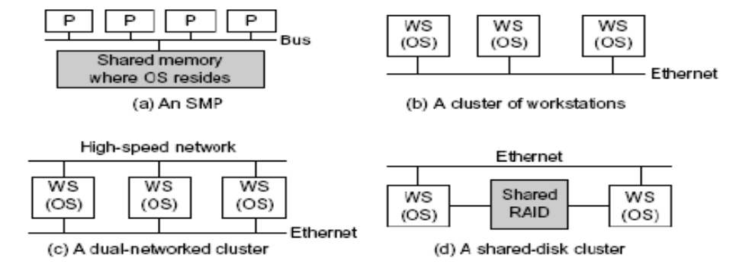
Single Points of Failure in SMP and Clusters
Birla Institute of Technology and Science, Pilani (Deemed University)

Slide 7

Fault Tolerant Cluster Configurations
Redundant components configured based on different cost, availability, and performance requirements.
The following three configurations are frequently used:
Hot Standby: A primary component provides service, while a redundant backup component stands by without doing any work, but is ready (hot) to take over as soon as the primary fails.
Mutual Takeover: All components are primary in that they all actively perform useful workload. When one fails, its workload is redistributed to other components. (More Economical)
Fault-Tolerance: Most expensive configuration, as N components deliver performance of only one component, at more than N times the cost. The failure of N–1 components is masked (not visible to the user).
Birla Institute of Technology and Science, Pilani (Deemed University)

Slide 8

Failover
Probably the most important feature demanded in current clusters for commercial applications.
When a component fails, this technique allows the remaining system to take over the services originally provided by the failed component.
A failover mechanism must provide several functions: failure diagnosis, failure notification, and failure recovery.
Failure diagnosis - detection of a failure and the location of the failed component that causes the failure.
  Commonly used technique - heartbeat, where the cluster nodes send out a stream of heartbeat messages to one another.
  If the system does not receive the stream of heartbeat messages from a node, it can conclude that either the node or the network connection has failed.
Birla Institute of Technology and Science, Pilani (Deemed University)

Slide 9

Cluster Job Scheduling and Management
A Job Management System (JMS) should have three parts:
A user server lets the user submit jobs to one or more queues, specify resource requirements for each job, delete a job from a queue, inquire about the status of a job or a queue.
A job scheduler that performs job scheduling and queuing according to job types, resource requirements, resource availability, and scheduling policies.
A resource manager that allocates and monitors resources, enforces scheduling policies, and collects accounting information.
Birla Institute of Technology and Science, Pilani (Deemed University)

Slide 10

Cluster Job Types
Several types of jobs execute on a cluster.
Serial jobs run on a single node.
Parallel jobs use multiple nodes.
Interactive jobs are those that require fast turnaround time, and their input/output is directed to a terminal.
  These jobs do not need large resources, and the users expect them to execute immediately, not made to wait in a queue.
Batch jobs normally need more resources, such as large memory space and long CPU time.
  But they do not need immediate response.
  They are submitted to a job queue to be scheduled to run when the resource becomes available (e.g., during off hours).
Birla Institute of Technology and Science, Pilani (Deemed University)

Slide 11

Multi-Job Scheduling Schemes
Cluster jobs may be scheduled to run at a specific time (calendar scheduling) or when a particular event happens (event scheduling).
Jobs are scheduled according to priorities based on submission time, resource needs, execution time, memory, disk, job type, and user identity.
With static priority, jobs are assigned priorities according to a predetermined, fixed scheme.
  A simple scheme is to schedule jobs in a first-come, first-serve fashion.
  Another scheme is to assign different priorities to users.
With dynamic priority, the priority of a job may change over time.
Birla Institute of Technology and Science, Pilani (Deemed University)

Slide 12
Scheduling Modes
Dedicated Mode :
Only one job runs in the cluster at a time, and at most one process of the job is assigned to a node at a time.
The single job runs until completion before it releases the cluster to run other jobs.
Space Sharing :
Multiple jobs can run on disjoint partitions (groups) of nodes simultaneously.
At most one process is assigned to a node at a time.
Although a partition of nodes is dedicated to a job, the interconnect and the I/O subsystem may be shared by all jobs.
Birla Institute of Technology and Science, Pilani (Deemed University)

Slide 13

Continued…
Time sharing :
Multiple user processes are assigned to the same node.
Time-sharing introduces the following parallel scheduling policies:
  Independent Scheduling (Independent): Uses the operating system of each cluster node to schedule different processes as in a traditional workstation.
  Gang Scheduling: Schedules all processes of a parallel job together. When one process is active, all processes are active.
  Competition with Foreign (Local) Jobs: Scheduling becomes more complicated when both cluster jobs and local jobs are running. The local jobs should have priority over cluster jobs.
    Dealing with Situation: Stay or Migrate job
Birla Institute of Technology and Science, Pilani (Deemed University)

Slide 14
Next session
Grid computing
Birla Institute of Technology and Science, Pilani (Deemed University)

